Slide 1

SOCIONICS
All slides are copyrighted by Jack Oliver Aaron of the World Socionics Society
A CRASH COURSE

Slide 2
8. BETA
All slides are copyrighted by Jack Oliver Aaron of the World Socionics Society

Slide 3
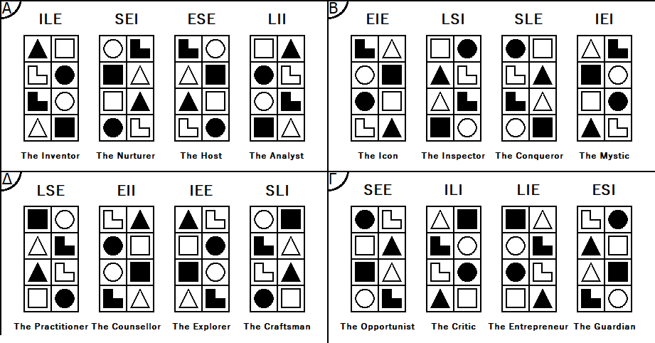
SO FAR
All slides are copyrighted by Jack Oliver Aaron of the World Socionics Society
Information Elements
Information Metabolism
Functions
Types
Alphas

Slide 4
WHAT’S NEXT
All slides are copyrighted by Jack Oliver Aaron of the World Socionics Society
Information Elements
Information Metabolism
Functions
Types
Alphas
Betas

Slide 5
BETA VALUES
All slides are copyrighted by Jack Oliver Aaron of the World Socionics Society
All Valued Elements are Conclusive.
Knowing what the truth really is with certainty
Acting on beliefs without compromise, changing the world
Having a passionate voice and influence, making others care
Belonging with those dedicated to a similarly higher path

Slide 6
BETA TABOOS
All slides are copyrighted by Jack Oliver Aaron of the World Socionics Society
All Neglected Elements are Questionable.
Quiet, cowardly disapproval, not challenging what bothers you
Living a boring, everyday life without something more special
Doubting your beliefs and instincts, changing who you are
Being complacent with the world, not mattering in the grander scheme

Slide 7
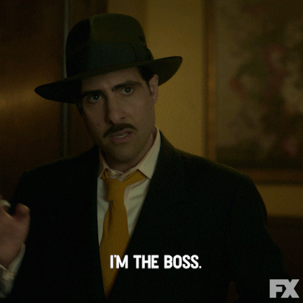
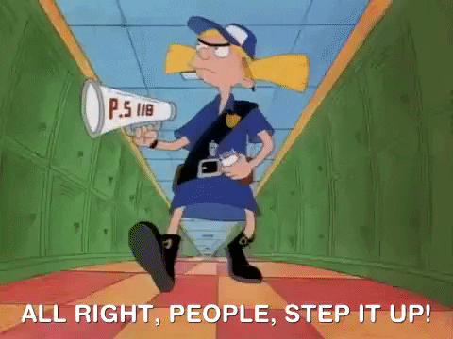
BETA REALISTS
All slides are copyrighted by Jack Oliver Aaron of the World Socionics Society
The truth is enforced in reality Establish certainty in the world Take charge and be the boss Control chaos and establish order
The Inspector - LSI
The Conqueror - SLE

Slide 8
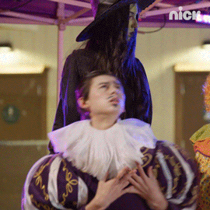

BETA HUMANITARIANS
All slides are copyrighted by Jack Oliver Aaron of the World Socionics Society
Express yourself authentically Emotions should be profound Discover your special destiny Bring inspiration to the world
The Icon - EIE
The Mystic - IEI

Slide 9



BETA ENERGISERS
All slides are copyrighted by Jack Oliver Aaron of the World Socionics Society
Shout out to the world Be intense and larger than life Maximise street cred and influence Be the deliverer of change
The Icon - EIE
The Conqueror - SLE

Slide 10

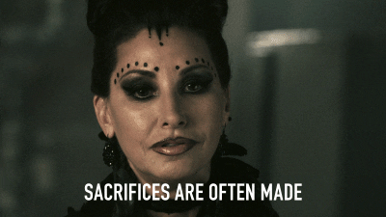
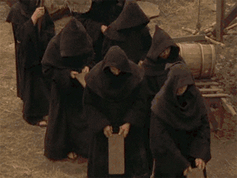
BETA INTEGRATORS
All slides are copyrighted by Jack Oliver Aaron of the World Socionics Society
Know the deep mysteries of the universe Stay on the true path Be truly dedicated to the cause Do not tolerate doubt
The Inspector - LSI
The Mystic - IEI

Slide 11

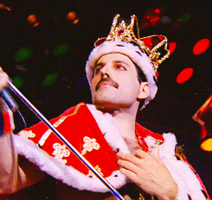
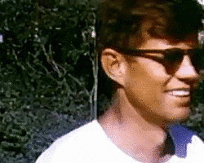

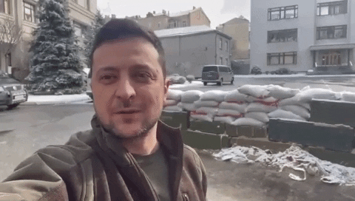
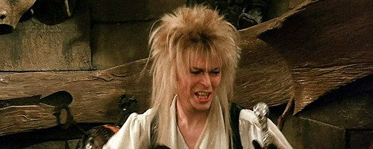
ETHICAL INTUITIVE ENERGISER - “THE ICON”
All slides are copyrighted by Jack Oliver Aaron of the World Socionics Society

Slide 12
EGO BLOCK
All slides are copyrighted by Jack Oliver Aaron of the World Socionics Society
All about authentic self-expression Full of dynamic passion Provoke others to feel strong emotions Communicate in a way that inspires Seeks emotional states that are profound Attracted to exclusive groups of belonging Can often ‘just know’ what will happen Looks to stand out from the ordinary
Notes:
Charlie Chaplin E1+T2: https://www.youtube.com/watch?v=J7GY1Xg6X20
John F. Kennedy E1+T2: https://www.youtube.com/watch?v=g25G1M4EXrQ

Slide 13
SUPER-EGO BLOCK
All slides are copyrighted by Jack Oliver Aaron of the World Socionics Society
Find practical skills boring to do Prefer dramatic over dry explanations Learn and apply facts in line with goals Prefer to solve problems through people Struggle to relax and unwind Can be very intense, from 0-100 Have no interest in being normal humdrum Find health and daily details a frustration
Notes:
Steve Jobs P3: https://www.youtube.com/watch?v=v_5KcoSwmg4
David Bowie S4: https://www.youtube.com/watch?v=iMdWY_Gn2DI

Slide 14
SUPER-ID BLOCK
All slides are copyrighted by Jack Oliver Aaron of the World Socionics Society
Struggle to order their thoughts May lose priorities in winning people over Craves certainty from others Rails against hypocrisy and unfairness Expresses raw, intense emotions Seeks positions of influence Hates to feel weak or vulnerable Cycle between impatience and self-doubt
Notes:
Kanye West L5: https://www.youtube.com/watch?v=LghXfuvMkww&t=30s
Joan Rivers F6: https://www.youtube.com/watch?v=6lKS-Et-VmE

Slide 15
ID BLOCK
All slides are copyrighted by Jack Oliver Aaron of the World Socionics Society
In tune with their personal attitudes Treat anyone nicely when happy Be harsh even to friends if angry Avoid being disapproving or judgmental Head full of creative ideas and influences Quickly identifies new potential Relaxes with creative pursuits Does not enjoy too much ambiguity
Notes:
Russell Brand R7+I8: https://www.youtube.com/watch?v=xMiug2sZ4Io

Slide 16
DOMINATION
All slides are copyrighted by Jack Oliver Aaron of the World Socionics Society
Focused on expressing how they feel Do not let relationships constrict expression Will not deflate energy with personal stuff Airs one-to-one conversations to the room May prioritise public over private life
Notes:
Dr Frank N. Furter E1>R7: https://www.youtube.com/watch?v=bc80tFJpTuo
Bill Clinton E1>R7: https://www.youtube.com/watch?v=zrtq1ulbYFA

Slide 17
MASKING
All slides are copyrighted by Jack Oliver Aaron of the World Socionics Society
Strongly prefer emotive, uplifting conversation Dislike informing in a dry, matter-of-fact way Passionate about outcomes being achieved If necessary, will do the ‘boring’ practical stuff
Notes:
David Cameron E1 -> P3: https://www.youtube.com/watch?v=kOOfpSkzrb4

Slide 18
STRUGGLE
All slides are copyrighted by Jack Oliver Aaron of the World Socionics Society
Reluctantly learns facts to become competent Finds too much information unexciting Need something cohesive to feel passion for Want someone to make sense of it all Freed by coherent theories that explain things
Notes:
Tony Blair P3>L5: https://www.youtube.com/watch?v=mbfJxbTYtRs
Constantine the Great P3>L5: https://www.youtube.com/watch?v=9y7c9vweo8k

Slide 19
DISTRACTION
All slides are copyrighted by Jack Oliver Aaron of the World Socionics Society
Normally open to clear, logical explanations If people are not happy, give one-to-one time Can then lose sight of general principles Need the right mood to seek logic

Slide 20
MASTERY
All slides are copyrighted by Jack Oliver Aaron of the World Socionics Society
Balance breadth and depth of insight Look across many different ideas/influences Synthesise insights into long-term vision Weigh up both opportunities and risks Think ‘out the box’ in reaching their purpose
Notes:
Lady Gaga T2<I8: https://www.youtube.com/watch?v=U23lwilMafU
David Bowie T2<I8: https://www.youtube.com/watch?v=TajCh41y17I

Slide 21
GROWTH
All slides are copyrighted by Jack Oliver Aaron of the World Socionics Society
Open to ideas and perspectives But want to be strong and taken seriously Become more assertive and impatient to act Fall back on doubt and questioning if unsure
Notes:
Tony Blair I8 -> F6: https://www.youtube.com/watch?v=AZUMEgHmCY8
Adolf Hitler I8 > F6: https://www.youtube.com/watch?v=FJ3N_2r6R-o

Slide 22
SUBSTITUTION
All slides are copyrighted by Jack Oliver Aaron of the World Socionics Society
Value what is profound over what is pleasant Mentally very engaged but struggle to relax Sacrifice daily maintenance for big picture Ignore details, unless relevant, then stresses
Notes:
Lady Gaga S4 -> T2: https://www.youtube.com/watch?v=wV1FrqwZyKw

Slide 23
HUBRIS
All slides are copyrighted by Jack Oliver Aaron of the World Socionics Society
Blind to the peaceful, natural flow of things Yet want to be strong and impactful Try to be decisive, proactive and in charge Come off as too intense, disrupting the peace May be too hard on themselves, burning out
Notes:
David Bowie S4<F6: https://www.youtube.com/watch?v=t8CNhakfB7c

Slide 24
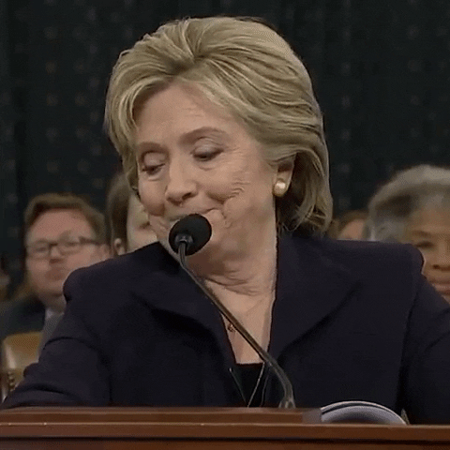
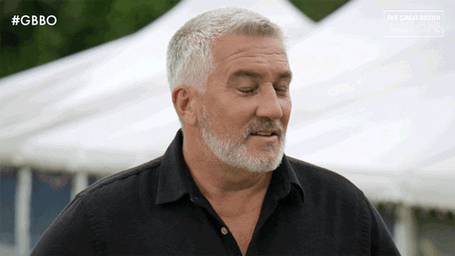
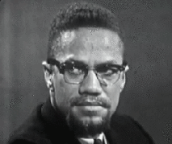
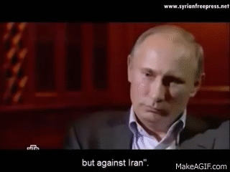
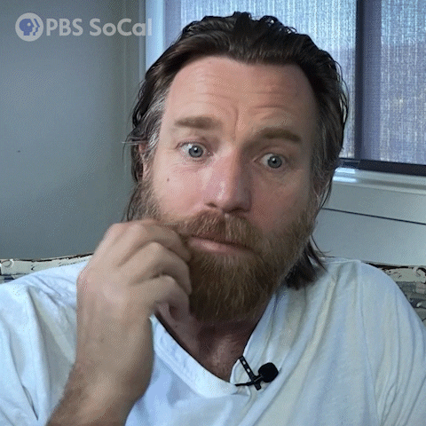
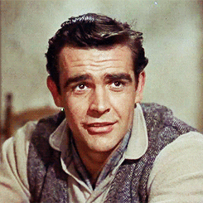
LOGICAL SENSORY INTEGRATOR - “THE INSPECTOR”
All slides are copyrighted by Jack Oliver Aaron of the World Socionics Society

Slide 25
EGO BLOCK
All slides are copyrighted by Jack Oliver Aaron of the World Socionics Society
All about bringing the world to order Formulates coherent rules and structures Creates systems of absolute clarity Follows principles without compromise Backs up rules with strong enforcement Maintains high levels of discipline Battles against contradicting views Expresses views with confident certainty
Notes:
Christopher Langan L1+F2: https://www.youtube.com/watch?v=Q-HXSHXUtFw&t=35s
Katharine Birbalsingh L1+F2: https://www.youtube.com/watch?v=QJ0qlwSowxw

Slide 26
SUPER-EGO BLOCK
All slides are copyrighted by Jack Oliver Aaron of the World Socionics Society
Dislikes bias or subjectivity Unlikely to make personal exceptions May find it hard to determine intentions Can determine whom they like/dislike Struggle to think outside own experiences Can be closed to other points of view May become overly narrow-minded Can reject things without considering them
Notes:
Joseph Stalin R3+I4: https://www.youtube.com/watch?v=IYFZawos3v0

Slide 27
SUPER-ID BLOCK
All slides are copyrighted by Jack Oliver Aaron of the World Socionics Society
Want to belong, but not to compromise Can be overly serious and rigid Susceptible to flattery Warms up to a energised mood Seek a greater purpose to existence Grow to become more spiritual over time Start to think more strategically Tend to fully commit to a grand purpose
Notes:
Hillary Clinton E5: https://www.youtube.com/watch?v=noBW8GvvoSw
Enoch Powell E5+T6: https://www.youtube.com/watch?v=mw4vMZDItQo&t=6s

Slide 28
ID BLOCK
All slides are copyrighted by Jack Oliver Aaron of the World Socionics Society
Good at learning practical information Able to apply principles effectively Follow their rules even if impractical Quick to dismiss odd facts as anomalies Highly detail aware, meticulous Good at sustaining energy over time Grounded in their daily experiences Unlikely to make mistakes
Notes:
Paul Hollywood P7+S8: https://www.youtube.com/watch?v=2cnkrtPZJNI

Slide 29
DOMINATION
All slides are copyrighted by Jack Oliver Aaron of the World Socionics Society
Wants to reach a ‘true’ understanding Insistent that theories align and make sense Avoid data-driven approaches to knowledge Feel that data is noisy and lacks signal Less interested in applying than knowing truth
Notes:
Christopher Langan L1>P7: https://www.youtube.com/watch?v=xwAffwDiy3A

Slide 30
MASKING
All slides are copyrighted by Jack Oliver Aaron of the World Socionics Society
Strongly prefer impartial, categorical view See systems and structures over individuals Often incorruptible, does not enjoy exceptions Can build more personal relationships if forced
Notes:
Malcolm X L1 -> R3: https://www.youtube.com/watch?v=xwAffwDiy3A

Slide 31
STRUGGLE
All slides are copyrighted by Jack Oliver Aaron of the World Socionics Society
Wants to rally people around their cause Lacks the charisma to appeal to the group Turns to winning allies one-to-one Individual patronage not universal acclaim Needs help getting collective buy-in
Notes:
Joseph Stalin R3 > E5: https://www.youtube.com/watch?v=i8vzLz08xOg

Slide 32
DISTRACTION
All slides are copyrighted by Jack Oliver Aaron of the World Socionics Society
Normally inspired by dramatic emotions Occasionally needs to be more factual Becomes unreceptive to the mood Can grow cold and dispassionate
Notes:
Peter Hitchens E5 -> P7: https://www.youtube.com/watch?v=p4xsk-SMA_8&t=195s

Slide 33
MASTERY
All slides are copyrighted by Jack Oliver Aaron of the World Socionics Society
Outwardly relaxed, but with inner steel Balance intensity with ability to sustain energy Highly disciplined in preventing mistakes Stands their ground, defends their space Establishes control by managing the details
Notes:
Vladimir Putin F2<S8: https://www.youtube.com/watch?v=co8s0egftsc

Slide 34
GROWTH
All slides are copyrighted by Jack Oliver Aaron of the World Socionics Society
Take daily comforts for granted Grows more visionary and strategic over time Chance of the grand purpose being false Regresses to focus on mundane details
Notes:
Peter Hitchens S8 -> T6: https://www.youtube.com/watch?v=VnIH4gomOqc&t=190s

Slide 35
SUBSTITUTION
All slides are copyrighted by Jack Oliver Aaron of the World Socionics Society
Sees truth in reality, not speculation Cuts through ambiguity to enforce certainty Enforces narrative against other perspectives Acts quickly and does not tolerate uncertainty
Notes:
Vladimir Putin I4 -> F2: https://www.youtube.com/watch?v=o9A-u8EoWcI

Slide 36
HUBRIS
All slides are copyrighted by Jack Oliver Aaron of the World Socionics Society
Blind to possibilities outside of experience Yet want to align to a greater purpose Commit to a far-reaching strategy Reject any possibility of changing their mind May advance blindly along the wrong path
Notes:
Pope Pius XIII I4<T6: https://www.youtube.com/watch?v=LmbyWGCwX90

Slide 37
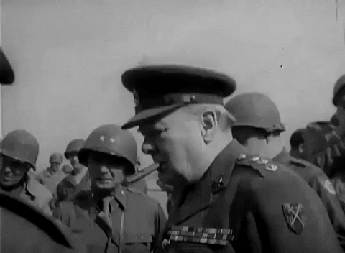
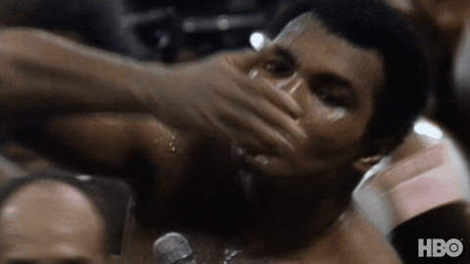
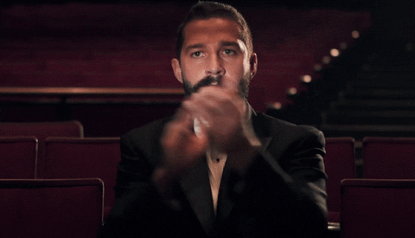
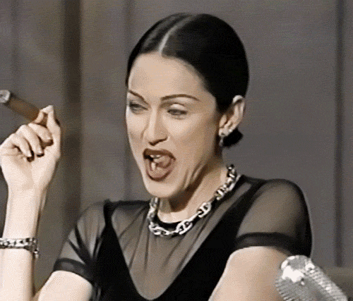


SENSORY LOGICAL ENERGISER - “THE CONQUEROR”
All slides are copyrighted by Jack Oliver Aaron of the World Socionics Society

Slide 38
EGO BLOCK
All slides are copyrighted by Jack Oliver Aaron of the World Socionics Society
All about competing and winning Scans the room, quickly jumps into action Highly assertive, able to dominate others Tackles issues directly, makes an impact Rapidly makes sense of information Confidently sets out how things are Introduces rules to control reality Challenges contradictions and hypocrisies
Notes:
Madonna F1: https://www.youtube.com/watch?v=-GrsjFmSRuk
Donald Trump F1: https://www.youtube.com/watch?v=cDuy0WY8twU
Donald Trump F1+L2: https://www.youtube.com/watch?v=JZRXESV3R74&t=13s

Slide 39
SUPER-EGO BLOCK
All slides are copyrighted by Jack Oliver Aaron of the World Socionics Society
Dislikes ambiguity or indecision Finds it frustrating to talk and speculate Need a reason to explore new options Can think out of the box to confuse others Don’t acknowledge personal sensitivities Intrude into people’s privacy Erratic in personal relationships Can neglect those close to them
Notes:
Jair Bolsonaro I3+R4: https://www.youtube.com/watch?v=dVdgCFJZmgI

Slide 40
SUPER-ID BLOCK
All slides are copyrighted by Jack Oliver Aaron of the World Socionics Society
Frequently superficial and directionless Not good at seeing further ahead Can act without thinking things through Desires a greater destiny to pursue Like to play up to a crowd Enjoy causing emotional reactions Attempts to win people over can backfire Want excitement and adoration
Notes:
Winston Churchill T5+E6: https://www.youtube.com/watch?v=skrdyoabmgA

Slide 41
ID BLOCK
All slides are copyrighted by Jack Oliver Aaron of the World Socionics Society
Prioritise ambitions over daily concerns Power through discomfort to win Live an intense life, not content to settle Exercise control over aesthetic details Quickly absorb lots of facts Does not expect competence from others Takes their problem-solving for granted Prefers heroic to pragmatic solutions
Notes:
Donald Trump S7: https://www.youtube.com/watch?v=KLpDxsokZD4
Donald Trump P8: https://www.youtube.com/watch?v=A8wJc7vHcTs

Slide 42
DOMINATION
All slides are copyrighted by Jack Oliver Aaron of the World Socionics Society
Inclined towards intensity of action ‘No pain no gain’, denies comfort for ambition Dominate surroundings, does not blend in Makes space competitive, not harmonised May not allow others to relax
Notes:
Theodore Roosevelt F1>S7: https://www.youtube.com/watch?v=Fs_1Yi4dy7A

Slide 43
MASKING
All slides are copyrighted by Jack Oliver Aaron of the World Socionics Society
Strongly prefer direct, forceful action Dislike open-ended speculation Do not want to be tied to a losing battle If necessary, will entertain alternative ideas
Notes:
Donald Trump F1 -> I3: https://www.youtube.com/watch?v=buIBuaDA7gI
Donald Trump F1 -> I3: https://www.youtube.com/watch?v=TFfUYe4KHL0

Slide 44
STRUGGLE
All slides are copyrighted by Jack Oliver Aaron of the World Socionics Society
Reluctantly entertains alternative ideas Does not like to feel distracted from action Think they need to account for possibilities Desire a clear destiny or vision to fight for Freed from pointlessness by having purpose
Notes:
Marlon Brando I3>T5: https://www.youtube.com/watch?v=p4xtO4RBwPs

Slide 45
DISTRACTION
All slides are copyrighted by Jack Oliver Aaron of the World Socionics Society
Normally receptive to a greater destiny If not in control, will obsess over details Lose sight of their purpose for daily comforts Need to be in charge to transcend the present

Slide 46
MASTERY
All slides are copyrighted by Jack Oliver Aaron of the World Socionics Society
Rapidly acquires factual information Balances structured and practical thinking Bolsters beliefs with factual research Restructures viewpoints so they make sense Able to quickly understand, explain and apply
Notes:
Candace Owens L2<P8: https://www.youtube.com/watch?v=TB7dQh_TpUc

Slide 47
GROWTH
All slides are copyrighted by Jack Oliver Aaron of the World Socionics Society
Take facts for granted, want to be loved Become more ‘showy’, less factual over time Playing up to the crowd can backfire Regress to less exciting, practical matters
Notes:
Conor McGregor P8 -> E6: https://www.youtube.com/watch?v=bJmz-e64fwI
Conor McGregor P8 -> E6: https://www.youtube.com/watch?v=E2KmO004G0Y&t=242s

Slide 48
SUBSTITUTION
All slides are copyrighted by Jack Oliver Aaron of the World Socionics Society
See objective rules, not subjective attitudes Default to logical criteria in personal matters Need a rational justification for liking/disliking Handle relationships with rules and categories
Notes:
Negan R4 -> L2: https://www.youtube.com/watch?v=D4JdkkukXS4

Slide 49
HUBRIS
All slides are copyrighted by Jack Oliver Aaron of the World Socionics Society
Blind to their personal attitudes, likes, dislikes Yet want people to shower them with love Pursue public recognition and popularity Overlook closer relationships, can be disloyal May lose public support due to personal life
Notes:
Silvio Berlusconi R4<E6: https://www.youtube.com/watch?v=TWzugdM_HQc
Silvio Berlusconi R4<E6: https://www.youtube.com/watch?v=_2xHB1FmWpk
Idi Amin R4<E6: https://www.youtube.com/shorts/vtatvBfwLEo

Slide 50
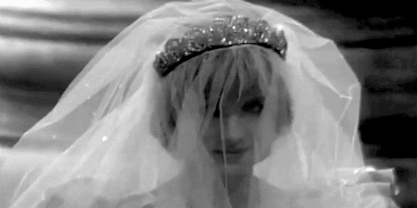

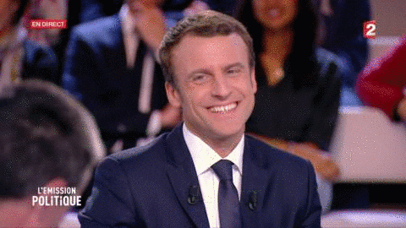
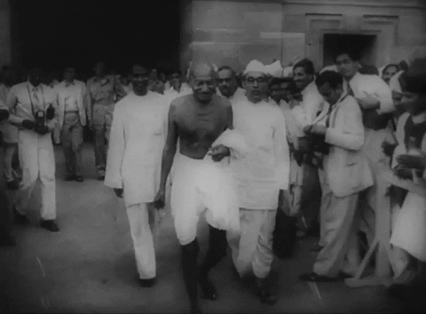
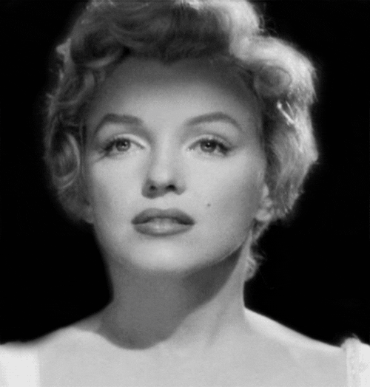
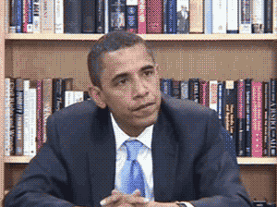
INTUITIVE ETHICAL INTEGRATOR - “THE MYSTIC”
All slides are copyrighted by Jack Oliver Aaron of the World Socionics Society

Slide 51
EGO BLOCK
All slides are copyrighted by Jack Oliver Aaron of the World Socionics Society
All about finding a greater meaning to life Reflects deeply on past and future Can see what is destined to happen Devoted to their calling or vision Wants people aligned to the vision Diplomatic, a subtle influencer Speaks passionately about the future Gains the buy in of others
Notes:
Kate Bush T1: https://www.youtube.com/watch?v=-1pMMIe4hb4 Barack Obama T1+E2: https://www.youtube.com/watch?v=OFPwDe22CoY

Slide 52
SUPER-EGO BLOCK
All slides are copyrighted by Jack Oliver Aaron of the World Socionics Society
Dislikes daily triviality and banality In their heads, detached from day to day Needs social pressure to manage details Can be more calm and relaxed if needed Struggle to practise and develop skills Dislike reality not matching up to the vision Impractical, does not know what to do Ignore evidence in forming beliefs
Notes:
Karl Marx S3+P4: https://mises.org/wire/visit-karl-marxs-apartment
Yoko Ono S3+P4: https://www.youtube.com/watch?v=HdZ9weP5i68&t=35s

Slide 53
SUPER-ID BLOCK
All slides are copyrighted by Jack Oliver Aaron of the World Socionics Society
Often stuck in their heads Delay enacting their vision Want to be energised into action Very pliable to external force or pressure Like to understand things clearly Enjoy carving out an area of expertise Attempts to show understanding can fail Want people to see they are not stupid
Notes:
Elijah Wood F5: https://www.youtube.com/watch?v=IfhMILe8C84
Emmanuel Macron F5: https://www.youtube.com/watch?v=1DwijJfVbBg
Mahatma Gandhi L6: https://www.youtube.com/watch?v=TkHTbkPoEQ8

Slide 54
ID BLOCK
All slides are copyrighted by Jack Oliver Aaron of the World Socionics Society
See possibilities but focus on the vision Avoids ideas that distract from purpose Not normally open to new perspectives See the path ahead, do not deviate Most influential on the one-to-one Know people’s intentions, forgiving Can take their relationships for granted Prefers larger than life over ‘nice’ people
Notes:
Karl Marx I7+R8: https://www.youtube.com/watch?v=j10hgmCXQYQ&t=45s

Slide 55
DOMINATION
All slides are copyrighted by Jack Oliver Aaron of the World Socionics Society
Want to fulfil their purpose and destiny in life Devoted to purpose, rejecting any distractions Avoid new possibilities, appear uninquisitive Explore everything that is relevant to them Disinterested in much of the world
Notes:
Kate Bush T1>I7: https://www.youtube.com/watch?v=AkLvn6pSDOA
Michael Jackson T1>I8: https://www.youtube.com/watch?v=ZkhOXXhSIhU

Slide 56
MASKING
All slides are copyrighted by Jack Oliver Aaron of the World Socionics Society
Pursue what is transcendent over trivial See day-to-day things as unimportant Feel they have to look ‘put together’ Foster calming spaces if expected of them
Notes:
Princess Diana T1 -> S3: https://www.youtube.com/watch?v=QqNI9aRUb3k&t=43s

Slide 57
STRUGGLE
All slides are copyrighted by Jack Oliver Aaron of the World Socionics Society
Naturally cautious in present day Feels the need to play things safe Finds the safe and secure very boring Admires those with strength and will to act Feel empowered and emboldened by others
Notes:
Friedrich Nietzsche S3>F5: https://www.youtube.com/watch?v=bxiKqA-u8y4
Friedrich Nietzsche S3>F5: https://www.youtube.com/watch?v=eMBVfPXCVVw

Slide 58
DISTRACTION
All slides are copyrighted by Jack Oliver Aaron of the World Socionics Society
Normally receptive to intensity and urgency Occasionally needs to find a new vision Grow distracted in exploration Need the path ahead to be spurred to action

Slide 59
MASTERY
All slides are copyrighted by Jack Oliver Aaron of the World Socionics Society
Natural at reading and adapting to the mood Great at balancing group and individual ties Connects each individual to the cluster Ensures that the mood is nice and positive Able to fit in while keeping close relationships
Notes:
Neil Gaiman E2<R8: https://www.youtube.com/watch?v=mqbJ5P6ZZ9c
Michael Jackson E2<R8: https://www.youtube.com/watch?v=ns4pq_gQIg0&t=53s

Slide 60
GROWTH
All slides are copyrighted by Jack Oliver Aaron of the World Socionics Society
Take bonds for granted, want to understand Grow more coherent, less partial over time Being the ‘expert’ can create a lot of pressure Regress to reliance on close friendships
Notes:
Plato R8 -> L6: https://www.youtube.com/watch?v=jLesc5lITvo
George Stroumboulopoulos R8 -> L6: https://www.youtube.com/watch?v=P1whhxDn-Ic&t=33s

Slide 61
SUBSTITUTION
All slides are copyrighted by Jack Oliver Aaron of the World Socionics Society
See how people feel, not what actually works Default to inspiring rather than informing Need social interactions to learn things Use emotional feedback to decide what works
Notes:
Michael Jackson P4 -> E2: https://www.youtube.com/watch?v=ZkhOXXhSIhU&t=8s
Alan Rickman P4 -> E2: https://www.youtube.com/watch?v=gML1cG0LZSE

Slide 62
HUBRIS
All slides are copyrighted by Jack Oliver Aaron of the World Socionics Society
Blind to how things work best in reality Yet want to be seen as comprehending ‘truth’ Create a school of thought they are a ‘guru’ in Rely wholly on a set theory or framework Reject evidence to contrary, looking kooky
Notes:
Pol Pot P4<L6: https://www.youtube.com/watch?v=g9aKxsg1_s8
Mahatma Gandhi P4<L6: https://www.youtube.com/watch?v=K8Vd-P1attQ

Slide 63
Any Questions?
All slides are copyrighted by Jack Oliver Aaron of the World Socionics Society
Email Jack at worldsocionics@hotmail.com

